Slide 1

Process Mining Virtual Internship
by
Nithin Kumar Reddy K
Roll No. 214G1A3269
Department of Computer Science and Engineering (Data Science)
Srinivasa Ramanujan Institute of Technology
(Affiliated to JNTUA & Approved by AICTE) (Accredited by NAAC with ‘A’ Grade & Accredited by NBA (EEE, ECE & CSE)
Rotarypuram Village, B K Samudram Mandal, Ananthapuramu – 515701.
2023 - 2024

Slide 2

Contents
Course Objective
Introduction
Technology
Applications
Modules
Real Time applications
Learning outcomes
GitHub Link
Queries

Slide 3
Course Objective
The main objectives of data mining are to identify patterns, discover relationships, and uncover insights that can be used to improve decision-making.
Data mining is a common technique that separates data points into different classes. It allows you to organize data sets of all sorts, including complex and large datasets as well as small and simple ones. It primarily involves using algorithms that you can easily modify to improve the data quality.

Slide 4
Introduction
Why use process mining?
Process mining helps auditors analyze data faster and enables you to predict where compliance issues and risk factors are likely to exist. Since process mining gives you complete insights into your processes, you get a clearer picture of potential problem areas.
The most common use case of process mining for consultants is in process improvement projects. As such, the use case is very similar to the one of Process Improvement Teams

Slide 5
Contd…
Properties of Data Mining:
1.Automatic discovery of patterns
2.Prediction of likely outcomes
3.Creation of actionable information
4.Focus on large datasets and databases
Classification of Data Mining:
1.Database Technology
2.Statistics
3.Machine Learning
4.Information Science
5.Visualization

Slide 6
Technology
To analyze the track processes
Process mining applies data science to discover, validate and improve workflows.
Tool that quickly analyzes all of your process data from various systems like an ERP, CRM or MES
Process mining, like any other data-driven analysis approach, needs to deal with data quality problems. A data source may be a simple flat file, an Excel spreadsheet, a transaction log, or a database table.

Slide 7
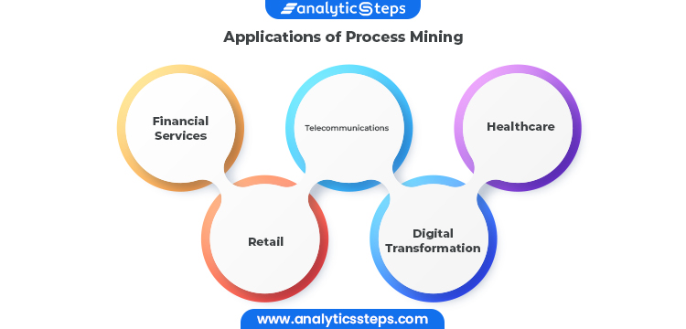
Applications
Financial services, telecommunications, healthcare, and retail are just a few examples of industries where process mining can be used for business process management and process improvement. These sectors have a wealth of data that can be used as a starting point, and process deviations from their intended behavior can have expensive repercussions.

Slide 8
Modules
Introduction to Process Mining:
A process is a systematic series of actions, tasks, or steps that are executed in a specific sequence to achieve a desired outcome or goal. Processes are fundamental to various fields, including business operations, manufacturing, software development, and more. They provide structure and organization to activities, ensuring that tasks are performed in an orderly and efficient manner.
Process mining has a wide range of uses across different industries and sectors. Its applications span from improving operational efficiency to ensuring compliance and driving digital transformation
Process mining uncovers opportunities to streamline or automate processes, for example, with robotic process automation (RPA).‍

Slide 9
Contd…
Implementation of Process Mining:
1. Identify the process(es) to be analyzed
2. Collect or integrate data
3. Verify data quality
4. Analyze the data
5. Interpret the results and implement changes
6. Monitor and adjust

Slide 10
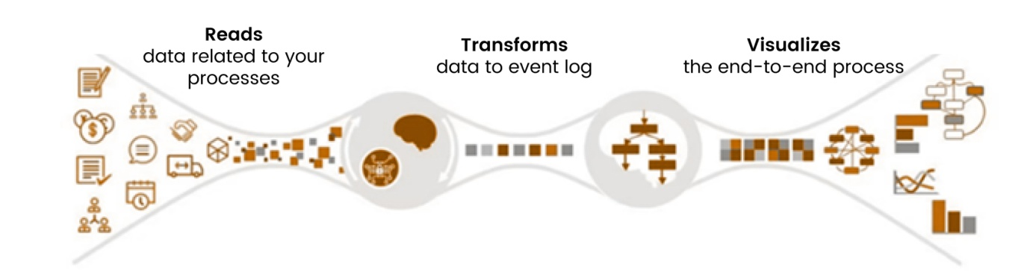
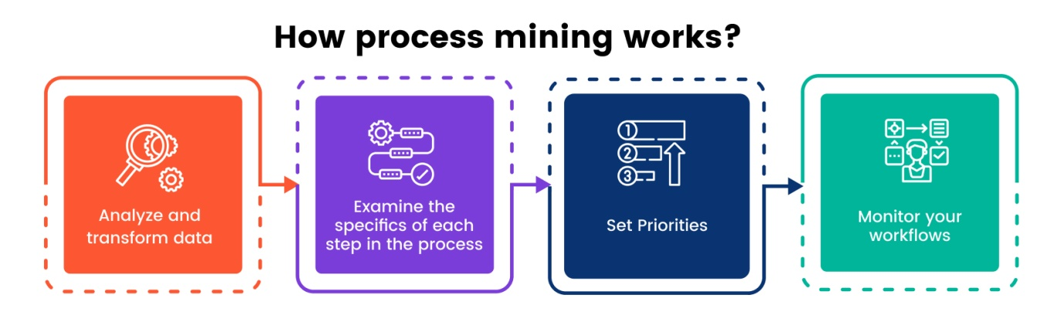
Contd…

Slide 11
Contd…
Get Data into the EMS:
In this topic we will study about two types they are Set up a data pipeline
Refine your Data Pipeline
In the set up a data pipeline again divide into sub parts they are
Data Integration basics
Connect to Systems
Extract Data
Transform Data
Load a Data Model

Slide 12
Contd…
Celonis Process Mining
The Celonis process mining platform is called the Execution Management System (EMS). In addition to traditional process mining functionality, the EMS offers a cloud-based solution for real-time data extraction and analysis, as well as task mining functionality. Celonis EMS also includes process modeling and process simulation functionality.
Top features:
Wide adoption
Integrations
Customization
Broad user community

Slide 13
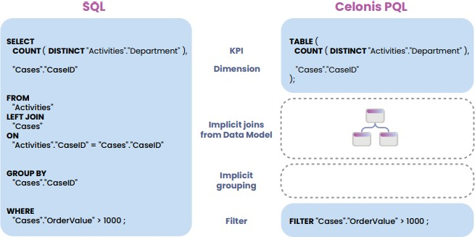
Contd…
Celonis PQL provides a wide range of different operators which can be combined to answer complex business questions. The following list gives an overview of the most important classes of operators.
Comparison of SQL and PQL

Slide 14
Real Time Applications
1. Retail: Inventory Management and Fulfillment
2. Healthcare: Patient Journey Analysis
3. Finance: Invoice Processing
4. Manufacturing: Production Line Efficiency
5. Customer Support: Helpdesk Operations
6. IT Service Management: Incident Handling
7. Logistics: Order Processing
8. Insurance: Claims Processing
9. Energy: Maintenance and Repairs
10. HR Process Mining:

Slide 15
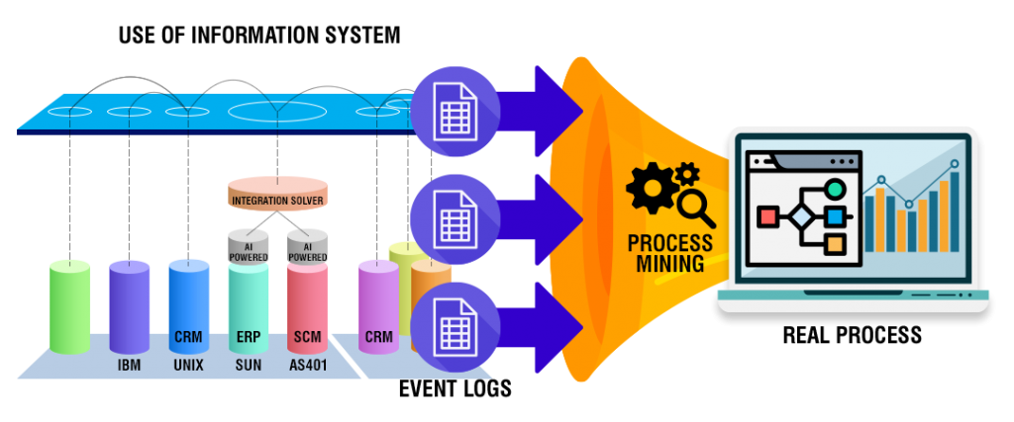
Contd…

Slide 16
Learning outcomes
Perform the basictasks necessary to build Celonis analyses.
Become familiar withAnalysis Settings and Permissions.
Publish analyses usingbest practices in version control.
Put your knowledgeabout the theoretical foundations of Process Mining into practice.
Save an analysisselection for future reference and share it with your team; exportvisualizations and process data.

Slide 17
Git Hub Dashboard and Link

Slide 18
Any Queries?

Slide 19
Thank You!!!

